Slide 1
PEPFAR’s Vision on HIV Rapid Testing Continuous Quality Improvements (HIV-RTCQI)
George Alemnji, PhD, MPH
Senior Technical Advisor and Team Lead, Laboratory and Surveillance ,
Bureau of Global Health Security and Diplomacy (GHSD) Washington DC
RTCQI Workshop, Panama August 26-830th, 2024, Panama City

Slide 2
Introduction
According to the U.S. CDC, 70% of medical decisions depend on laboratory test results.
A 1% test error is huge in the context of total tests performed. For example, consider a PEPFAR program which tests up to 80 million people a year. A 1% error rate is 800K and a 0.1% error rate is 80K.
Diagnostic errors have ethical, clinical and policy implications.
Timely delivery of accurate test results has important clinical, programmatic, and public health implications.
There is need for more innovations to support laboratory quality and timely data.
There is increasing evidence of countries not incorporating quality components in their algorithm.

Slide 3

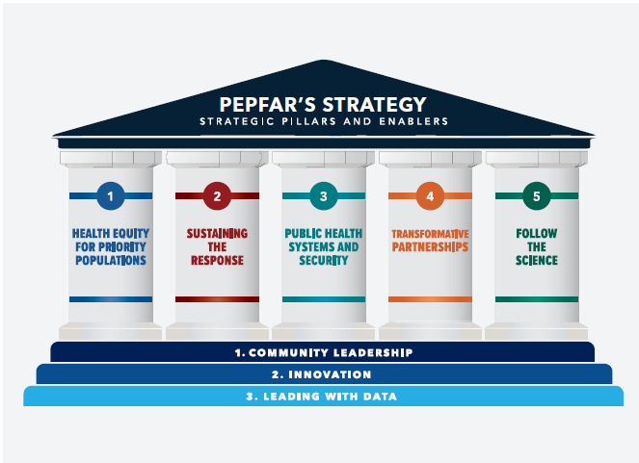
PEPFAR’s Five-year Strategy | Strategic Pillars and Enablers
5

Slide 4


Enablers
Strengthening and building the capacity of community leadership to support task sharing and identify and address critical barriers RTCQI
Need for more innovations in RTCQI process
High quality and integrated laboratory information management systems support data-driven decisions in laboratory policy development and program implementation

Slide 5
Quality and Timely Data
Quality Data
Data quality is the measure of how well suited a data set is to serve its specific purpose. Measures of data quality are based on data quality characteristics such as accuracy, completeness, consistency, validity, uniqueness, and timeliness.
Timely Data
Timeliness refers to expected time of availability and accessibility of data in making business decisions.

Slide 6
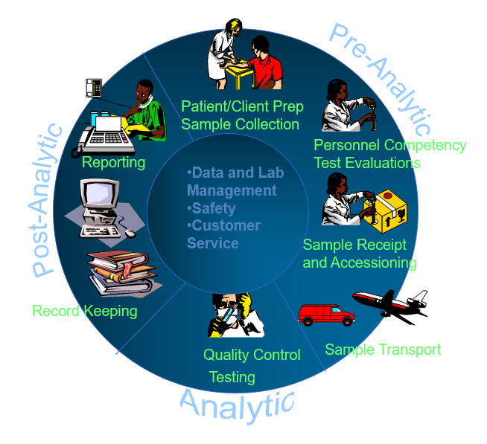
Lab Data Errors Occur in Pre-analytical, Analytical, or Post-analytical Phases
Overall, 1124 (58.5%)
Pre-analytical phase 807 (71.8%)
Analytical phase 85 (7.6%)
Post-analytical phase 232 (20.6%)
https://iris.who.int/bitstream/handle/10665/44665/9789241548274_eng.pdf?sequence=1
https://www.dovepress.com/assessment-of-types-and-frequ232 ency-of-errors-in-diagnostic-laboratories-peer-reviewed-fulltext-article-PLMI#:~:text=Laboratory%20error%20is%20defined%20as,interpreting%20and%20reacting%20to%20them%E2%80%9D.&text=An%20error%20in%20the%20clinical,impossible%20to%20perform%20error%2Dfree.

Slide 7

The Laboratory is Blamed for Every Error
More than half of the so called ‘’laboratory errors’’ have already happened before the analysis starts in the laboratory and many mistakes are made after the analysis itself. Pre- and post-analytical errors cause 60 to 90% of all unexpected or erroneous values; only 10 to 15% are caused by analytical problems.
https://pubmed.ncbi.nlm.nih.gov/25630293/

Slide 8

Programmatic and Public Health Impact of Misdiagnosis
Worsening the condition,
Confusion,
Being prescribed the wrong medication,
Not being prescribed medication,
Lost time seeing other healthcare providers,
Overall impact on the national surveillance system
Impact on programmatic and policy decision making
https://www.hst.org.za/publications/NonHST%20Publications/Programmatic%20and%20public%20health.pdf

Slide 9

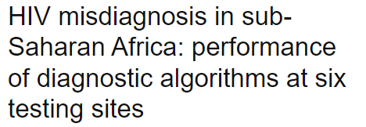
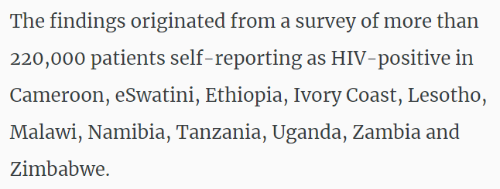
The Magnitude of HIV Misdiagnosis in Africa
The performance of algorithms at several sites failed to meet expectations and thresholds set by the World Health Organization, with unacceptably high rates of false results.
https://www.researchgate.net/publication/318034391_HIV_misdiagnosis_in_subSaharan_Africa_performance_of_diagnostic_algorithms_at_six_testing_sites
https://www.healio.com/news/infectious-disease/20190506/73k-people-may-be-misclassified-as-hivpositive-in-11-african-countries

Slide 10
How do we Minimize Diagnostic Errors?

Slide 11

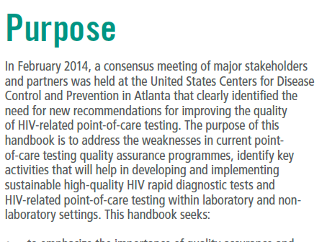
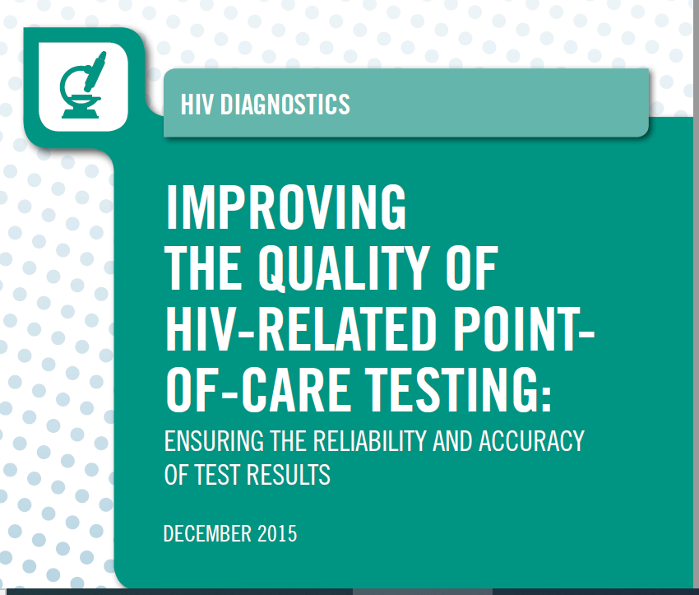


Slide 12
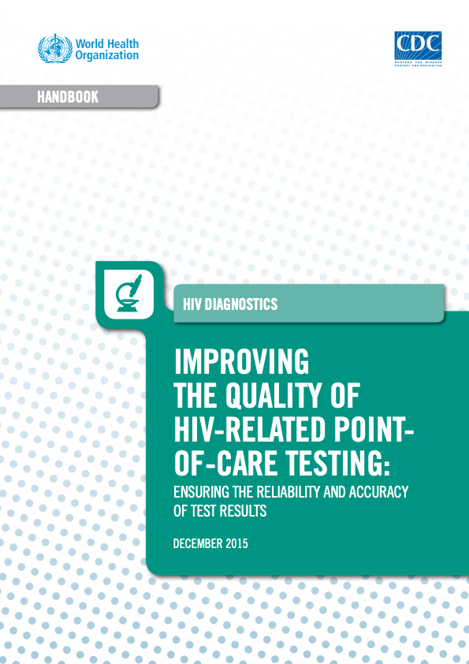
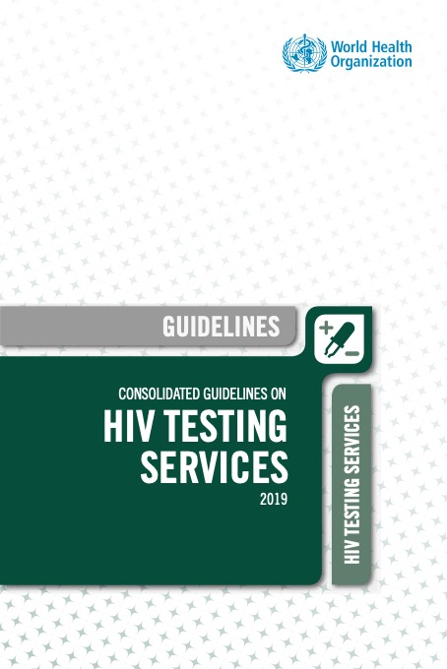
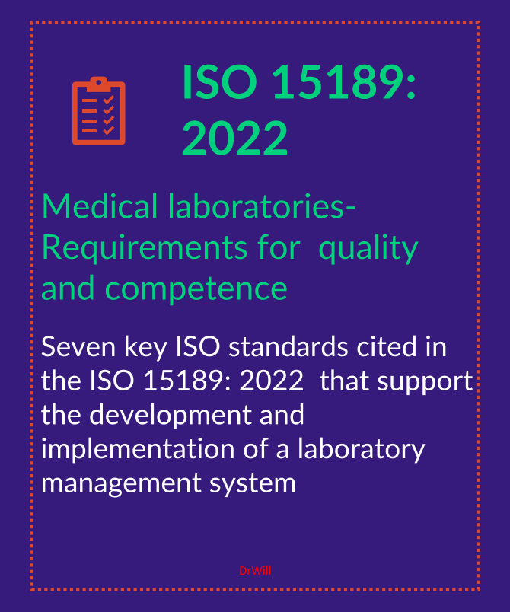


WHO Guides
2011 2015 2015 & 2019 2022
CDC, WHO Lyon; Laboratory quality management system: handbook
WHO improving the quality of HIV-related point-of-care testing:
ensuring the reliability and accuracy of test results
WHO Consolidated guidelines on HIV testing services quality chapter
ISO 15189: 2022
https://www.who.int/publications/i/item/9789241548274
https://iris.who.int/bitstream/handle/10665/199799/9789241508179_eng.pdf
https://www.iso.org/standard/76677.html
https://iris.who.int/handle/10665/336323
LQMS Training Toolkit and LQSI tool
RTCQI and SPI-RT and SPI-POCT
SLMTA and SLIPTA check list
Notes:
1) is designed for laboratory technicians, nurses, and counselors at test sites. It provides them with the knowledge and skills to perform HIV rapid tests accurately and reliably in a safe and professional manner. The training package includes a trainer's guide, participant's manual, CD of all files, training video/DVD, job aides, and curriculum posters.

Slide 13
Programs, Tools, and training for POCT
To ensure trained non-laboratory personnel conduct HIV rapid testing at decentralized sites.
Solution: CDC and WHO developed a multi-pronged approach for quality assurance and certification of testing staff. (RT-CQI) based on WHO guidelines on improving the quality of HIV-related point-of-care testing (2015) that uses SPI-RT
Key Components :
This program is implemented in most PEPFAR-supported countries to support accurate and reliable rapid HIV testing
HIV Rapid Test-Continuous Quality Improvement (RT-CQI) program and SPI-RT checklist
Guidelines and policies for QA and QI of HIV RT.
Certification program for testers and testing sites
Scaling up PT programs
Improving uptake of standardized HIV testing logbook
Strengthening capacity to ensure the quality of rapid HIV test kits
Challenges of using resources in countries without external support
non-PEPFAR-supported countries or countries not having support from a third party, can not easily implement QA
Notes:
So here we have QI rather than QMS

Slide 14

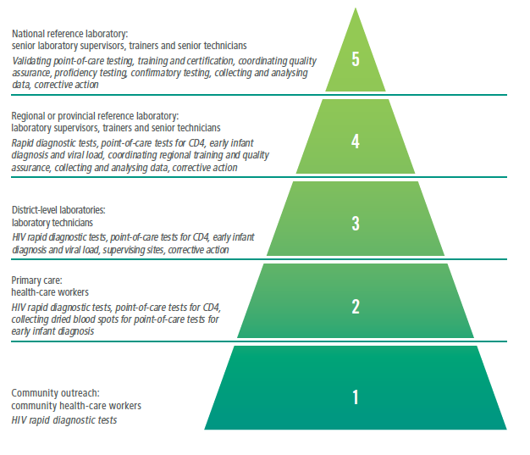
Need for Quality Testing at All Levels of Tiered Health Systems

Slide 15

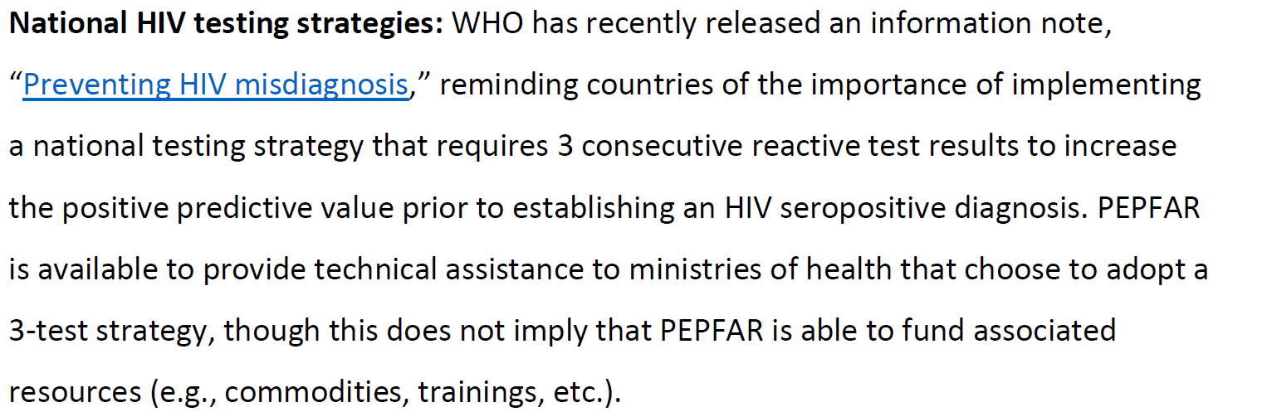
HIV Testing Strategies | Quality of Testing is More Critical than Just Testing Strategy

Slide 16
Key Enablers of Successful HIV Quality Testing
Ensure strong CQI processes, including the incorporation of HIV RT-CQI, for all countries, regardless of the testing algorithm being used.
Encourage all countries implementing either algorithm to conduct retesting for verification before commencing ART. Retesting for verification will significantly improve the PPV even with the 2-test algorithm.
Encourage strong post market surveillance for all testing approaches.

Slide 17
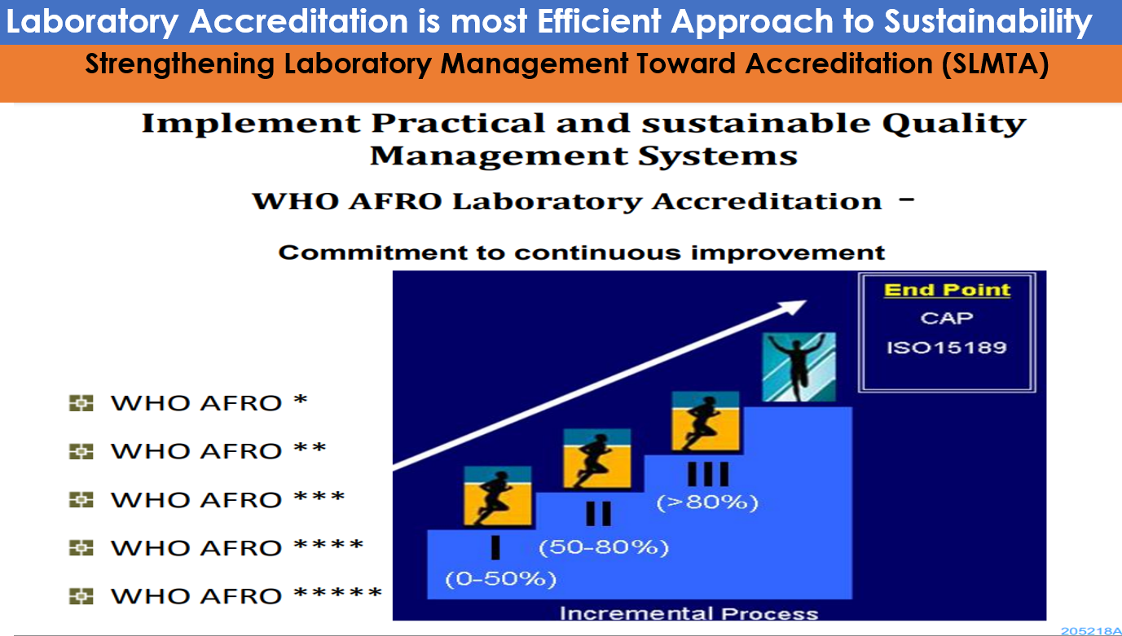
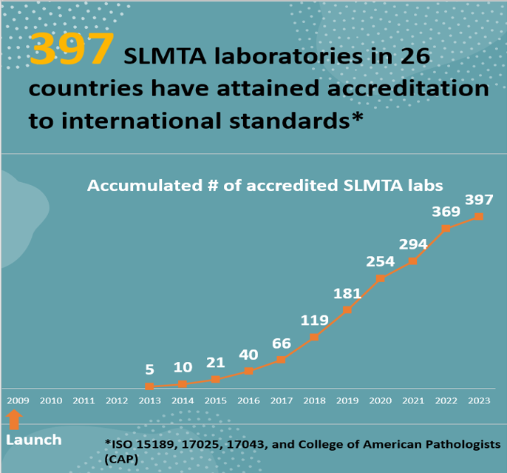
Quality Improvement and Accreditation | Key to Minimizing Diagnostic Errors

Slide 18
How do we Ensure Availability of Timely Data?

Slide 19



Improved Turn-Around TIME (TAT)

Slide 20

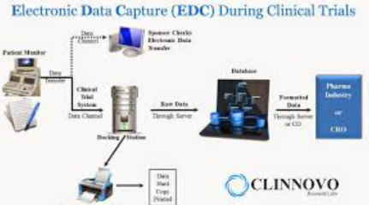

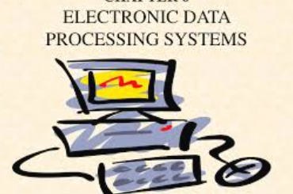
Transition from paper based to Electronic Data Systems to Improve TAT and Minimize Error
Paper Based System
Electronic Based System

Slide 21
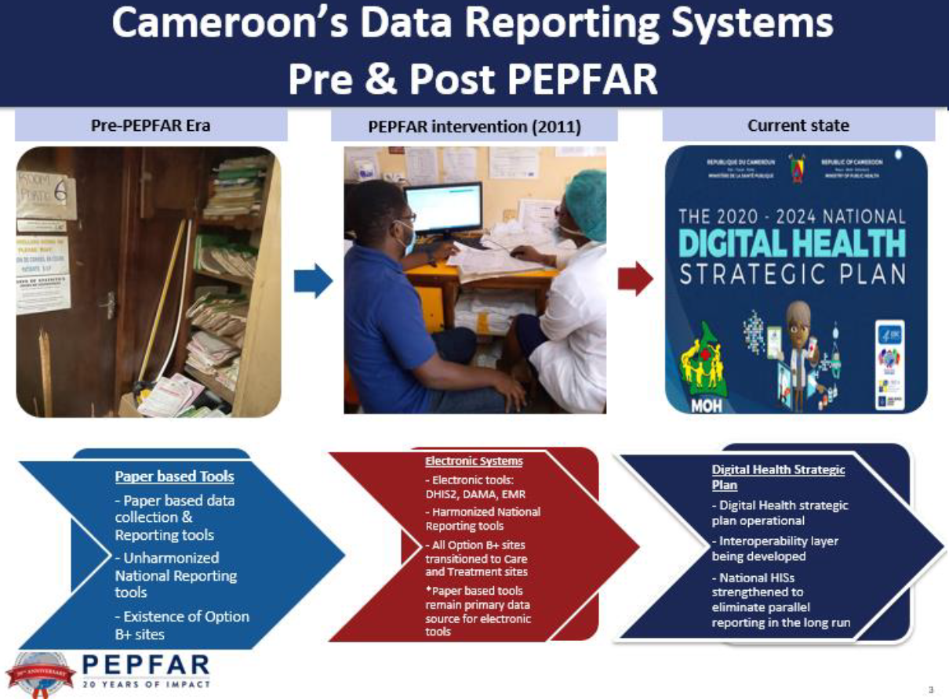

Slide 22
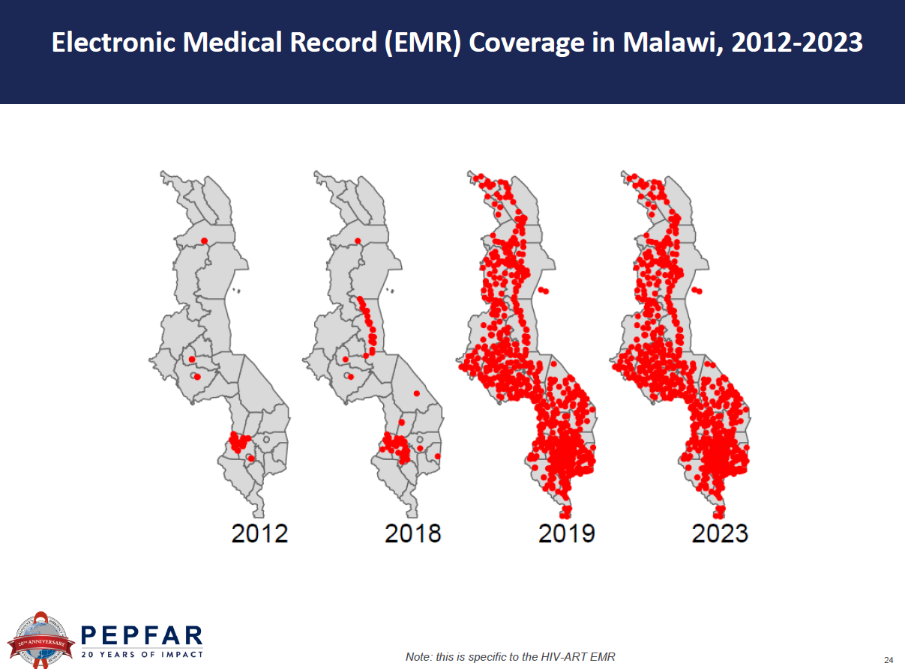

Slide 23
Data/Publications Supporting HIV-RTCQI Activities

Slide 24
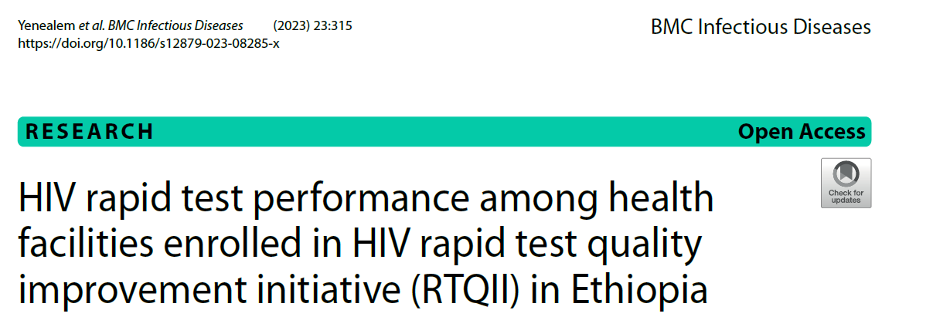
Results: The overall acceptable performance (100% PT score with the correct algorithm followed) was found to be 62% while 12% scored 80% and 11% scored between 20 and 60%. The rest 15% were not considered as acceptable due to failure to adhere to the National HIV Testing Algorithm. Testing sites that participated in External Quality Assessment/Proficiency Testing schemes have shown better performance than those that did not participate with 70% and 56% performance respectively (p=0.057).

Slide 25
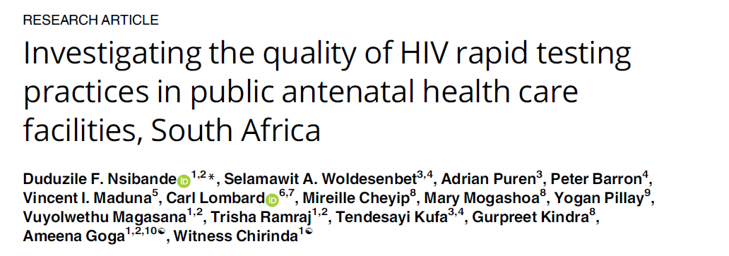
Facilities in districts implementing the HIV Rapid Test Quality Improvement Initiatives and supported by the President’s Emergency Plan for AIDS Relief (PEPFAR) had significant higher median overall scores (65.6% IQR: 53.9-74.2%) (P-value from rank sum test:<0.001) compared with non-PEPFAR-supported facilities (56.6% IQR:47.7-66.0%). We found sub-optimal implementation of HIV rapid testing practices. We recommend the expansion of the PEPFAR-funded Rapid Testing Continuous Quality Improvement (RTCQI) support to all Antennal care testing sites.

Slide 26
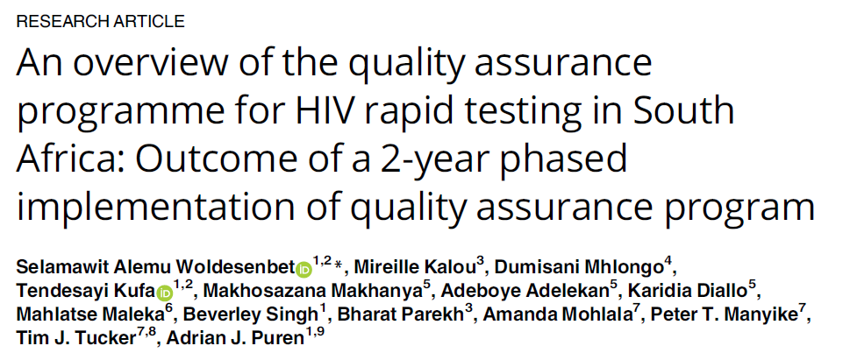
Conclusion: Facilities performance on the domains that are critical for accuracy of diagnosis
(i.e. pre-testing, testing and post-testing) remained largely unchanged. This study provided
several recommendations to improve QA implementation in South Africa, including the need
to improve routine use of internal control for corrective action

Slide 27
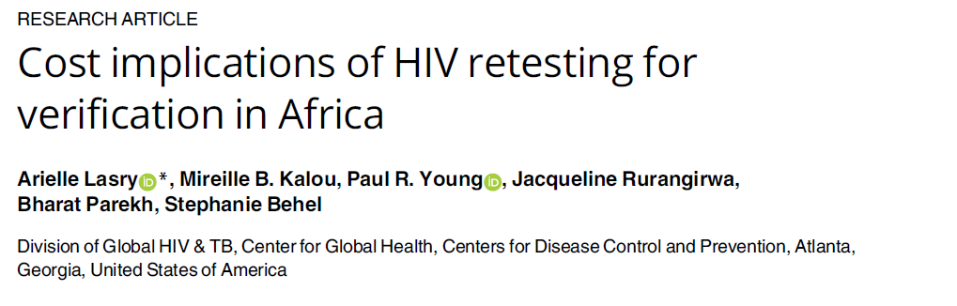
Conclusion: Results show that to reduce HIV misdiagnosis, countries in Africa should implement the WHO’s recommendation of retesting for verification prior to ART initiation,
as part of a comprehensive quality assurance program for HIV testing services.

Slide 28
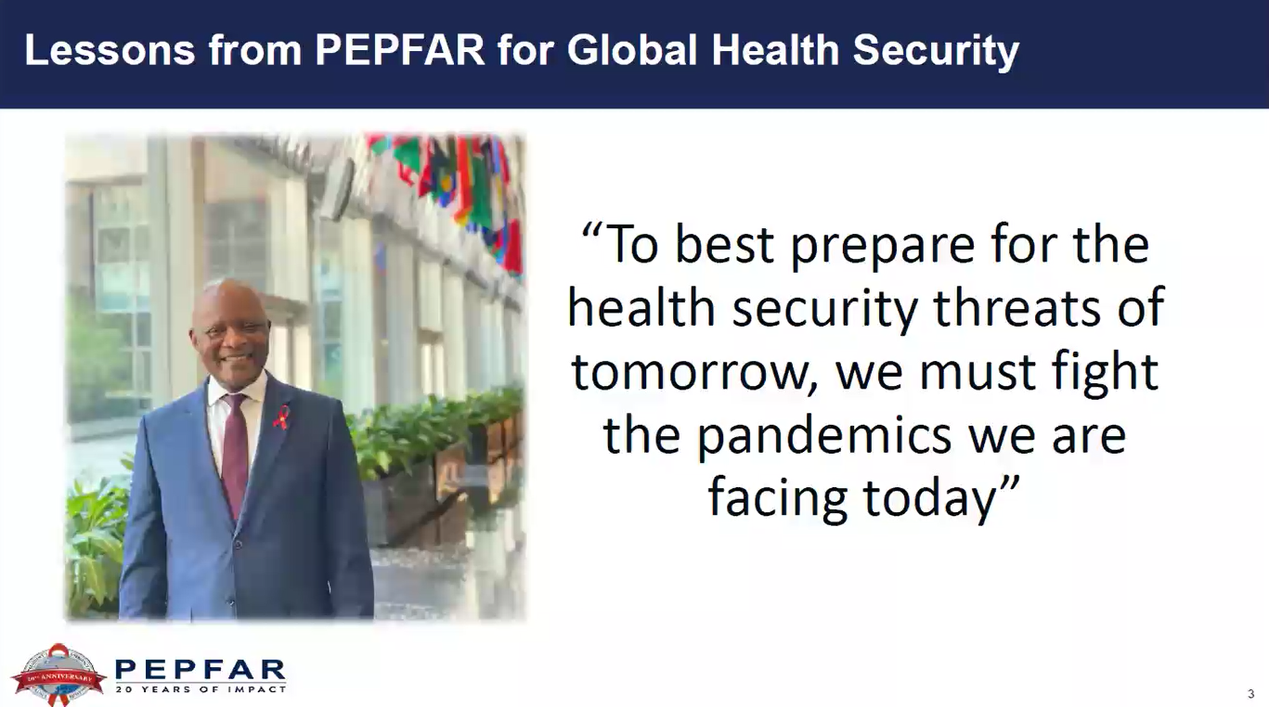

Slide 29
Thank you

